Slide 1
18AIC302J Web programming for Artificial Intelligence UNIT-2 JavaScript & JQuery

Slide 2
JavaScript: Introduction
The JavaScript language
History and Versions of JavaScript
• JavaScript was introduced as part of the Netscape 2.0 browser.
• Microsoft soon released its own version called JavaScript .
• European Computer Manufacturers Association (ECMA) developed a standard language known as ECMAScript.
• ECMAScript Edition 3 is widely supported and is what we will call “JavaScript”

Slide 3
JavaScript: Introduction
• JavaScript was designed to add interactivity to HTML pages.
• JavaScript is a scripting language.
• A scripting language is a lightweight programming language.
• JavaScript is usually embedded directly into HTML pages.
• JavaScript is an interpreted language (means that scripts execute without preliminary compilation)

Slide 4
JavaScript can do
• JavaScript gives HTML designers a programming tool - HTML authors are normally not programmers, but JavaScript is a scripting language with a very simple syntax! Almost anyone can put small code into their HTML pages
• JavaScript can put dynamic text into an HTML page - A JavaScript statement like this: document.write("<h1>" + name + "</h1>") can write a variable text into an HTML page.
• JavaScript can react to events - A JavaScript can be set to execute when something happens, like when a page has finished loading or when a user clicks on an HTML element.
• JavaScript can read and write HTML elements - A JavaScript can read and change the content of an HTML element.

Slide 5
JavaScript can do
• JavaScript can be used to validate data - A JavaScript can be used to validate form data before it is submitted to a server. This saves the server from extra processing.
• JavaScript can be used to detect the visitor's browser - A JavaScript can be used to detect the visitor's browser, and - depending on the browser - load another page specifically designed for that browser.
• JavaScript can be used to create cookies - A JavaScript can be used to store and retrieve information on the visitor's computer The example below shows how to use JavaScript to write text on a web page:

Slide 6
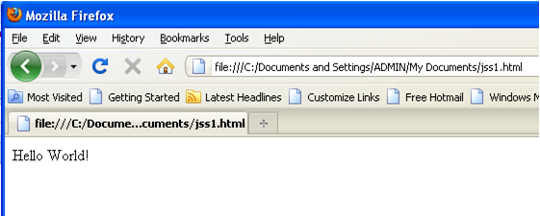
JavaScript: Example
<script type="text/javascript"> <!-- document.write("Hello World!") //--> </script>

Slide 7
JavaScript: Introduction
Example Explained
• To insert a JavaScript into an HTML page, we use the <script> tag.
• Inside the <script> tag we use the type attribute to define the scripting language.
• So, the <script type="text/javascript"> and </script> tells where the JavaScript starts and ends:
<html>
<body>
<script type="text/javascript">
...
</script>
</body>
</html>

Slide 8
JavaScript: Introduction
• The document.write command is a standard JavaScript command for writing output to a page.
• By entering the document.write command between the <script> and </script> tags, the browser will recognize it as a JavaScript command and execute the code line.
• The <!-- introduces an HTML comment. To get JavaScript to ignore the HTML close comment, -->,
• the // starts a JavaScript comment, which extends to the end of the line.
• JavaScript can be put in the <head> or in the <body> of an HTML document.
• JavaScript functions should be defined in the <head>.
• This ensures that the function is loaded before it is needed.
• JavaScript in the <body> will be executed as the page loads. J
• avaScript can be put in a separate .js file.
<script src="myJavaScriptFile.js"></script>

Slide 9
JavaScript: Introduction
Using an External JavaScript
• you can write a JavaScript in an external file. Save the external JavaScript file with a .js file extension.
• The external script cannot contain the <script></script> tags!
• To use the external script, point to the .js file in the "src" attribute of the <script> tag:
Example
<html>
<head>
<script type="text/javascript" src="xxx.js"></script>
</head>
<body>
</body>
</html>
JavaScript is Case Sensitive
Unlike HTML, JavaScript is case sensitive - therefore watch your capitalization closely when you write JavaScript statements, create or call variables, objects and functions.

Slide 10
Topic : Basic Syntax–Structure of JS

Slide 11
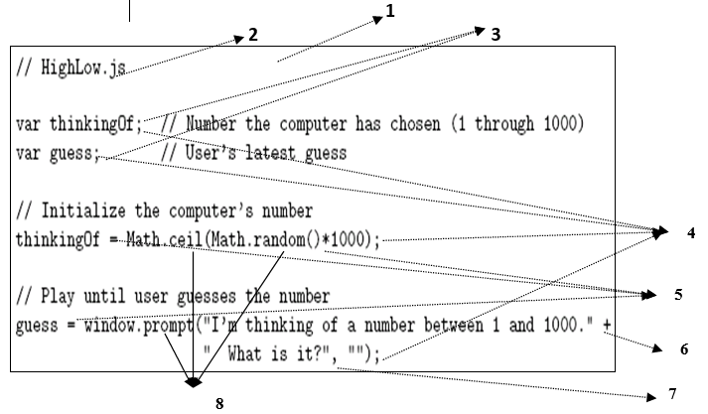
JavaScript: Basic Syntax

Slide 12
JavaScript: Basic Syntax
Notice that there is no main() function/method
Comments like Java/C++ (/* */ also allowed)
Variable declarations: Not required Data type not specified
Semi-colons are usually not required, but always allowed at statement end
Arithmetic operators same as Java/C++
String concatenation operator as well as addition
Argument lists are comma-separated
Object dot notation for method calls as in Java/C++

Slide 13
DataTypes-Variables

Slide 14
Datatypes-Variables
JavaScript variables are used to hold values or expressions.
A variable can have a short name, like x, or a more descriptive name, like carname.
Rules for JavaScript variable names: Variable names are case sensitive (y and Y are two different variables).
Variable names must begin with a letter or the underscore character.
Because JavaScript is case-sensitive, variable names are case-sensitive.
Type of a variable is dynamic: depends on the type of data it contains. JavaScript has six data types:
Number
String
Boolean (values true and false)
Object
Null (only value of this type is null)
Undefined (data type represented by variable that has been declared but has not yet been assigned a value)
The five JavaScript data types other than Object are referred to as Primitive data types.
typeof operator returns string related to data type

Slide 15
Datatypes-Variables

Slide 16
Control Structures

Slide 17
Conditional statements
Conditional statements are used to decide the flow of execution based on different conditions. If a condition is true, you can perform one action and if the condition is false, you can perform another action.
Different Types of Conditional Statements
If statement
If…Else statement
If…Else If…Else statement

Slide 18
Conditional statements
The if Statement
Use the if statement to specify a block of JavaScript code to be executed if a condition is true.
Syntax
if (condition) { // block of code to be executed if the condition is true }

Slide 19
Conditional statements
The if Statement
Use the if statement to specify a block of JavaScript code to be executed if a condition is true.
Syntax
if (condition) { // block of code to be executed if the condition is true }

Slide 20
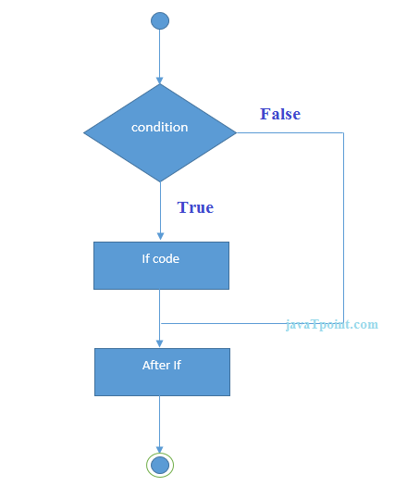
Flowchart of JavaScript If statement

Slide 21
The else Statement
Use the else statement to specify a block of code to be executed if the condition is false.
Syntax
if (condition) { // block of code to be executed if the condition is true } else { // block of code to be executed if the condition is false }

Slide 22
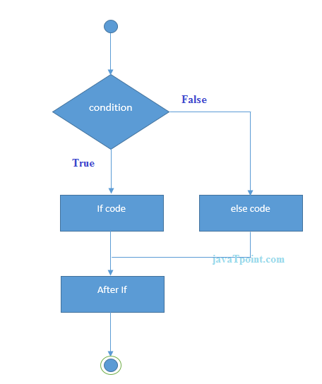
Flowchart of JavaScript If...else statement

Slide 23
JavaScript If...else if statement
It evaluates the content only if expression is true from several expressions. The signature of JavaScript if else if statement is given below.
Syntax
if(expression1){
//content to be evaluated if expression1 is true
}
else if(expression2){
//content to be evaluated if expression2 is true
}
else if(expression3){
//content to be evaluated if expression3 is true
}
else{
//content to be evaluated if no expression is true
}

Slide 24
JavaScript Switch
The JavaScript switch statement is used to execute one code from multiple expressions.
Syantax:
switch(expression){
case value1:
code to be executed;
break;
case value2:
code to be executed;
break;
......
default:
code to be executed if above values are not matched;
}

Slide 25
Functions

Slide 26
Functions
Functions
A function will be executed by an event or by a call to the function.
To keep the browser from executing a script when the page loads, you can put your script into a function.
A function contains code that will be executed by an event or by a call to the function.
You may call a function from anywhere within a page
Functions can be defined both in the <head> and in the <body> section of a document.
However, to assure that a function is read/loaded by the browser before it is called, it could be wise to put functions in the <head> section.

Slide 27
Functions
How to Define a Function
Syntax
function functionname(var1,var2,...,varX)
{
some code
}
• The parameters var1, var2, etc. are variables or values passed into the function.
• The { and the } defines the start and end of the function.
• A function with no parameters must include the parentheses () after the function name.
function name(arg1, …, argN) { statements }
• The function may contain return value; statements.
• Any variables declared within the function are local to it.
• The syntax for calling a function is just
name(arg1, …, argN)
Simple parameters are passed by value, objects are passed by reference

Slide 28
Functions
JavaScript Function Example
<html>
<head>
<script type="text/javascript">
function displaymessage()
{
alert("Hello World!");
}
</script>
</head>
<body>
<form>
<input type="button" value="Click me!" onclick="displaymessage()" />
</form>
</body>
</html>
• If the line: alert("Hello world!!") in the example above had not been put within a function,
• it would have been executed as soon as the line was loaded. before a user hits the input button.
• Now, the script is not executed • The function displaymessage() will be executed if the input button is clicked.

Slide 29
Functions
The return Statement
The return statement is used to specify the value that is returned from the function. So, functions that are going to return a value must use the return statement. The example below returns the product of two numbers (a and b).
Example
<html>
<head>
<script type="text/javascript">
function product(a,b)
{
return a*b;
}
</script>
</head>
<body>
<script type="text/javascript">
document.write(product(4,3));
</script>
</body>
</html>

Slide 30
Functions
Function call semantics details:
• Arguments:
• May be expressions:
• Object’s effectively passed by reference.
• Formal parameters:
• May be assigned values, argument is not affected (see example at the end of page 210)
• Return value:
• If last statement executed is not a return-value statement, then returned value is of type Undefined
• Number mismatch between argument list and formal parameter list:
• More arguments: excess ignored
• Fewer arguments: remaining parameters are given Undefined value

Slide 31
JAVASCRIPT ARRAYS

Slide 32
JAVASCRIPT ARRAYS
An array is a special variable, which can hold more than one value, at a time. If you have a list of items (a list of car names, for example), storing the cars in single variables could look like this
cars1="Saab";
cars2="Volvo";
cars3="BMW";
Create an Array
An array can be defined in three ways. The following code creates an Array object called
myCars:
1.
var myCars=new Array(); // regular array (add an optional integer
myCars[0]="Saab"; // argument to control array's size)
myCars[1]="Volvo";
myCars[2]="BMW";
2:
var myCars=new Array("Saab","Volvo","BMW"); // condensed array
3:
var myCars=["Saab","Volvo","BMW"]; // literal array

Slide 33
JAVASCRIPT ARRAYS
Access an Array
You can refer to a particular element in an array by referring to the name of the array and the index number. The index number starts at 0. The following code line:
document.write(myCars[0]);
Will result in the following output:
Saab
• Modify Values in an Array
• To modify a value in an existing array, just add a new value to the array with a specified index number:
myCars[0]="Opel";
Now, the following code line:
document.write(myCars[0]);
will result in the following output:
Opel
The Array built-in object can be used to construct objects with special properties and that inherit various methods

Slide 34
Java Script Events
DOM Handling

Slide 35
DOM Handling
Introduction to the Document Object Model
• The Document Object Model (DOM) is an API that allows programs to interact with HTML (or XML) documents.
• DOM is an interface that permits scripts to access and update the content, structure and style of the document.
• DOM is a W3C standard.
• DOM reads the entire HTML (or XML) document into memory and stores it as a tree data structure.
• DOM is slow and requires huge amounts of memory, so it cannot be used for large XML documents.

Slide 36
DOM Handling
DOM Objects:
• Every element of the web page can be dynamically updated in response to input from the user or other programs.
• HTML elements are treated as objects; their attributes are treated as properties of the objects
• JavaScript programs access the DOM through a host object named document.
• A number of other host objects. alert, prompt are examples

Slide 37
DOM Handling
DOM History and Levels
• With JavaScript you can restructure an entire HTML document.
• You can add, remove, change, or reorder items on a page.
• To change anything on a page, JavaScript needs access to all elements in the HTML document.
• This access, along with methods and properties to add, move, change, or remove HTML elements, is given through the Document Object Model (DOM).
➢ Very simple DOM was part of Netscape 2.0. Starting with Netscape 4.0 and IE 4.0, browser DOM API’s diverged significantly.
➢ In 1998, W3C published the Level 1 DOM specification.
➢ This specification allowed access to and manipulation of every single element in an HTML page.
➢

Slide 38
DOM Handling
DOM History and Levels
➢ All browsers have implemented this recommendation, and therefore, incompatibility problems in the DOM have almost disappeared.
➢ The DOM can be used by JavaScript to read and change HTML, XHTML, and XML documents.
➢ The DOM is separated into different parts (Core, XML, and HTML) and different levels (DOM Level 1/2/3):
1. Core DOM - defines a standard set of objects for any structured document
2. XML DOM - defines a standard set of objects for XML documents
3. HTML DOM - defines a standard set of objects for HTML documents

Slide 39
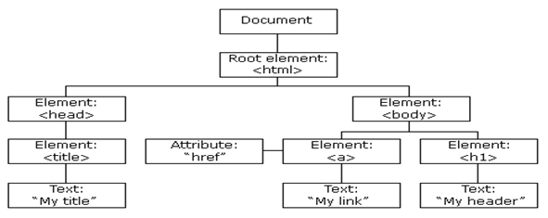
DOM Handling
The HTML DOM (Document Object Model)
When a web page is loaded, the browser creates a Document Object Model of the page.
The HTML DOM model is constructed as a tree of Objects:

Slide 40
DOM Handling
With the object model, JavaScript gets all the power it needs to create dynamic HTML:
• JavaScript can change all the HTML elements in the page
• JavaScript can change all the HTML attributes in the page
• JavaScript can change all the CSS styles in the page
• JavaScript can remove existing HTML elements and attributes
• JavaScript can add new HTML elements and attributes
• JavaScript can react to all existing HTML events in the page
• JavaScript can create new HTML events in the page.

Slide 41
JavaScript Can Change HTML Content
One of many JavaScript HTML methods is getElementById().
The example below "finds" an HTML element (with id="demo"), and changes the element content (innerHTML) to "Hello JavaScript“.
innerHTML
To access an HTML element, JavaScript can use the document.getElementById(id) method.
The id attribute defines the HTML element. The innerHTML property defines the HTML content
Example
<!DOCTYPE html>
<html>
<body>
<h2>What Can JavaScript Do?</h2>
<p id="demo">JavaScript can change HTML content.</p>
<button type="button" onclick="document.getElementById('demo').innerHTML = 'Hello JavaScript!'">Click Me!</button>
</body>
</html>

Slide 42
Events Handling
JavaScript changes the value of the src (source) attribute of an <img> tag
Example
<button onclick="document.getElementById('myImage').src='pic_bulbon.gif'">Turn on the light</button>
Changing the style of an HTML element, is a variant of changing an HTML attribute.
Example:
document.getElementById("demo").style.fontSize = "35px";
Hiding HTML elements can be done by changing the display style
Example:
document.getElementById("demo").style.display = "none";
Showing hidden HTML elements can also be done by changing the display style.
Example:
document.getElementById("demo").style.display = "block";

Slide 43
Events Handling
The <script> Tag
In HTML, JavaScript code is inserted between <script> and </script> tags.
Example
<!DOCTYPE html>
<html>
<body>
<h2>JavaScript in Body</h2>
<p id="demo"> </p>
<script>
document.getElementById("demo").innerHTML = "My First JavaScript";
</script>
</body>
</html>

Slide 44
Events Handling
A JavaScript function is a block of JavaScript code, that can be executed when "called" for.
For example, a function can be called when an event occurs, like when the user clicks a button.
You can place any number of scripts in an HTML document.
Scripts can be placed in the <body>, or in the <head> section of an HTML page, or in both.
JavaScript in <head>
In this example, a JavaScript function is placed in the <head> section of an HTML page.
The function is invoked (called) when a button is clicked:

Slide 45
Events Handling <head>
<!DOCTYPE html>
<html>
<head>
<script>
function myFunction() {
document.getElementById("demo").innerHTML = "Paragraph changed.";
}
</script>
</head>
<body>
<h2>Demo JavaScript in Head</h2>
<p id="demo">A Paragraph.</p>
<button type="button" onclick="myFunction()">Try it</button>
</body>
</html>

Slide 46
Events Handling <body>
<!DOCTYPE html>
<html>
<body>
<h2>Demo External JavaScript</h2>
<p id="demo">A Paragraph.</p>
<button type="button" onclick="myFunction()">Try it</button>
<p>This example links to "External_script.js".</p>
<p>(myFunction is stored in "External_script.js")</p>
<script src=“Path://External_script.js"></script>
</body>
</html>

Slide 47
Events Handling <body>
In this example, a JavaScript function is placed in the <body> section of an HTML page.
The function is invoked (called) when a button is clicked.
<!DOCTYPE html>
<html>
<body>
<h2>Demo JavaScript in Body</h2>
<p id="demo">A Paragraph.</p>
<button type="button" onclick="myFunction()">Try it</button>
<script>
function myFunction() {
document.getElementById("demo").innerHTML = "Paragraph changed.";
}
</script> </body></html>

Slide 48
Events Handling – External js file
Scripts can also be placed in external files
External file: myScript.js
Function myFunction() { document.getElementById("demo").innerHTML = "Paragraph changed."; }
External scripts are practical when the same code is used in many different web pages.
JavaScript files have the file extension .js.

Slide 49
Validation
Validation
• You can use JavaScript to
• Make sure that your form contain valid information
• Check data in one field against data in another field (choose a new password)
• Highlight incorrect information to let the user know what needs to be changed
Example1
FormPsw.htm
If passwd1 ==“”
tell the user to enter a password and reposition the cursor to the correct field
If passwd1!=passwd2
tell the user the 2 passwords don’t match and reposition the cursor
<form name=“changepsw” >
your name: <input type="text" size="30">
<p>choose a password: <input type="password" name="passwd1">
<p>verify password: <input type="password" name="passwd2">
<p><input type="submit" value="submit"> <input type="reset">
</form>

Slide 50
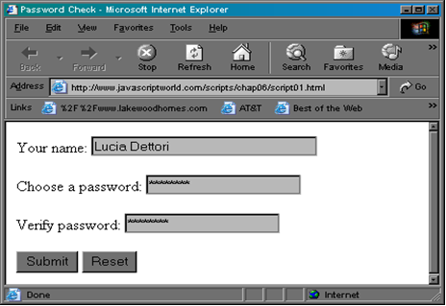
Validation

Slide 51
jQuery

Slide 52
jQuery
jQuery is a lightweight, "write less, do more", JavaScript library.
The purpose of jQuery is to make it much easier to use JavaScript on your website.
jQuery takes a lot of common tasks that require many lines of JavaScript code to accomplish, and wraps them into methods that you can call with a single line of code.
jQuery also simplifies a lot of the complicated things from JavaScript, like AJAX calls and DOM manipulation.

Slide 53
jQuery History
jQuery was first released in January 2006 by John Resig at BarCamp NYC.
It is currently headed by Timmy Wilson and maintained by a team of developers.
Now a days we can use jQuery2.1

Slide 54
jQuery
What is jQuery
jQuery is a small and lightweight JavaScript library.
jQuery is cross-platform.
jQuery means "write less do more".
jQuery simplifies AJAX call and DOM manipulation.

Slide 55
jQuery Features
HTML manipulation
DOM manipulation
DOM element selection
CSS manipulation
Effects and Animations
Utilities
AJAX
HTML event methods
JSON Parsing
Extensibility through plug-ins

Slide 56
Why jQuery is required
It is very fast and extensible.
It facilitates the users to write UI related function codes in minimum possible lines.
It improves the performance of an application.
Browser's compatible web applications can be developed.
It uses mostly new features of new browsers.

Slide 57
Downloading jQuery
There are two versions of jQuery available for downloading:
Production version - this is for your live website because it has been minified and compressed
Development version - this is for testing and development (uncompressed and readable code)
Both versions can be downloaded from jQuery.com.
The jQuery library is a single JavaScript file, and you reference it with the HTML <script> tag (notice that the <script> tag should be inside the <head> section):
<head> <script src="jquery-3.6.0.min.js"></script> </head>

Slide 58
jQuery CDN
If you don't want to download and host jQuery yourself, you can include it from a CDN (Content Delivery Network).
Google is an example of someone who host jQuery:
Google CDN:
<head> <script src="https://ajax.googleapis.com/ajax/libs/jquery/3.6.0/jquery.min.js"></script> </head>

Slide 59
jQuery Syntax
The jQuery syntax is tailor-made for selecting HTML elements and performing some action on the element(s).
Basic syntax is: $(selector).action()
A $ sign to define/access jQuery
A (selector) to "query (or find)" HTML elements
A jQuery action() to be performed on the element(s)
Syntax:
$(document).ready(function(){ // jQuery methods go here... });
$(function() {
// jQuery methods go here...});
$(document).ready() and $()
The code inserted between $(document).ready() is executed only once when page is ready for JavaScript code to execute.
In place of $(document).ready(), you can use shorthand notation $() only.

Slide 60
Examples:
$(document).ready(function(){
$(".demo").css("background-color", "red" );
$("#demo1").css("color", "yellow");
$("h1").hide();
// $("#demo1").hide();
// $("p").css("color", "blue");
});
Examples:
$(this).hide() - hides the current element.
$("p").hide() - hides all <p> elements.
$(".test").hide() - hides all elements with class="test".
$("#test").hide() - hides the element with id="test".

Slide 61
jQuery Selectors
The element Selector
The jQuery element selector selects elements based on the element name.
You can select all <p> elements on a page like this:
$("p")
Example:
$(document).ready(function(){ $("button").click(function(){ $("p").hide(); }); });
Notes:
S3 Slot

Slide 62
The #id Selector
The jQuery #id selector uses the id attribute of an HTML tag to find the specific element.
An id should be unique within a page, so you should use the #id selector when you want to find a single, unique element.
To find an element with a specific id, write a hash character, followed by the id of the HTML element:
$("#test")
Example
$(document).ready(function(){ $("button").click(function(){ $("#test").hide(); }); });

Slide 63
The .class Selector
The jQuery .class selector finds elements with a specific class.
To find elements with a specific class, write a period character, followed by the name of the class:
$(".test")
Example
$(document).ready(function(){ $("button").click(function(){ $(".test").hide(); }); });

Slide 64
Universal (*) Selector
The jQuery .* selector finds elements with a specific class.
To find elements with a specific class, write a period character, followed by the name of the class:
$(".test")
Example
$(document).ready(function(){ $("button").click(function(){ $(“*").hide(); }); });
Universal(*)It selects all elements available in a DOM.

Slide 65
Multiple Element Selector
The element Selector
The jQuery element selector selects elements based on the element name.
You can select all <p> elements on a page like this:
$("p ,h1,h3")
Example:
$(document).ready(function(){
$("p, h1, h3").css("color", "blue");
});

Slide 66
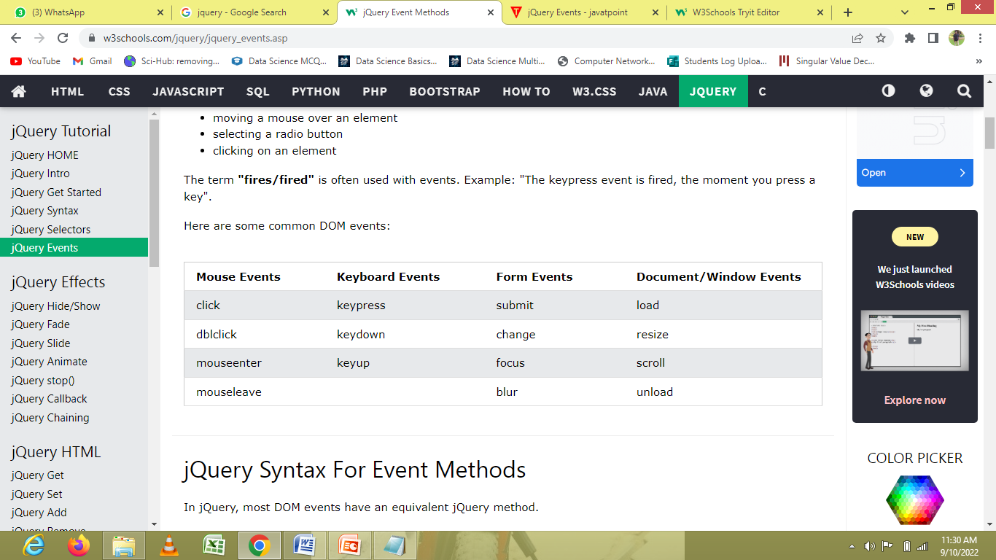
jQuery Events
jQuery events are the actions that can be detected by your web application. They are used to create dynamic web pages.
These are some examples of events.
A mouse click
An HTML form submission
A web page loading
A keystroke on the keyboard
Scrolling of the web page etc.

Slide 67
jQuery Syntax For Event Methods
To assign a click event to all paragraphs on a page, you can do this:
$("p").click();
The next step is to define what should happen when the event fires. You must pass a function to the event:
$("p").click(function(){ // action goes here!! });

Slide 68
Events
click()
The click() method attaches an event handler function to an HTML element.
The function is executed when the user clicks on the HTML element.
Example:
$("p").click(function(){ $(this).hide(); });
dblclick()
The dblclick() method attaches an event handler function to an HTML element.
The function is executed when the user double-clicks on the HTML element:
Example
$("p").dblclick(function(){ $(this).hide();});
mouseenter()
The mouseenter() method attaches an event handler function to an HTML element.
The function is executed when the mouse pointer enters the HTML element:
Example
$("#p1").mouseenter(function(){ alert("You entered p1!");});

Slide 69
mouseleave()
The mouseleave() method attaches an event handler function to an HTML element.
The function is executed when the mouse pointer leaves the HTML element:
Example
$("#p1").mouseleave(function(){ alert("Bye! You now leave p1!"); });
mousedown()
The mousedown() method attaches an event handler function to an HTML element.
The function is executed, when the left, middle or right mouse button is pressed down, while the mouse is over the HTML element:
Example
$("#p1").mousedown(function(){ alert("Mouse down over p1!"); });

Slide 70
mouseup()
The mouseup() method attaches an event handler function to an HTML element.
The function is executed, when the left, middle or right mouse button is released, while the mouse is over the HTML element:
Example
$("#p1").mouseup(function(){ alert("Mouse up over p1!"); });
hover()
The hover() method takes two functions and is a combination of the mouseenter() and mouseleave() methods.
The first function is executed when the mouse enters the HTML element, and the second function is executed when the mouse leaves the HTML element:
Example
$("#p1").hover(function(){ alert("You entered p1!"); },
function(){ alert("Bye! You now leave p1!"); });

Slide 71
focus()
The focus() method attaches an event handler function to an HTML form field.
The function is executed when the form field gets focus:
Example
$("input").focus(function(){ $(this).css("background-color", "#cccccc"); });
blur()
The blur() method attaches an event handler function to an HTML form field.
The function is executed when the form field loses focus:
Example
$("input").blur(function(){ $(this).css("background-color", "#ffffff"); });

Slide 72
jQuery Animation Effects
An animation lets an element gradually change from one style to another.
Animation is a method by which still figures are manipulated to appear as moving images.
The animate() Method
The jQuery animate() method is used to create custom animations.
Syntax:
$(selector).animate({params},speed,callback);
Here, params parameter defines the CSS properties to be animated.
The speed parameter is optional and specifies the duration of the effect. It can be set as "slow" , "fast" or milliseconds.
The callback parameter is also optional and it is a function which is executed after the animation completes

Slide 73
jQuery Animations - The animate() Method
Example
$("button").click(function(){ $("div").animate({left: '250px'}); });

Slide 74
jQuery animate() - Manipulate Multiple Properties
Notice that multiple properties can be animated at the same time
Example
$("button").click(function(){ $("div").animate({ left: '250px', opacity: '0.5', height: '150px', width: '150px' }); });

Slide 75
jQuery animate() - Using Relative Values
It is also possible to define relative values ( the value is then relative to the element's current value).
This is done by putting += or -= in front of the value:
Example
$("button").click(function(){ $("div").animate({ left: '250px', height: '+=150px', width: '+=150px' }); });

Slide 76
jQuery animate() - Uses Queue Functionality
By default, jQuery comes with queue functionality for animations.
This means that if you write multiple animate() calls after each other, jQuery creates an "internal" queue with these method calls. Then it runs the animate calls ONE by ONE.
So, if you want to perform different animations after each other, we take advantage of the queue functionality:
Example 1
$("button").click(function(){ var div = $("div"); div.animate({height: '300px', opacity: '0.4'}, "slow"); div.animate({width: '300px', opacity: '0.8'}, "slow"); div.animate({height: '100px', opacity: '0.4'}, "slow"); div.animate({width: '100px', opacity: '0.8'}, "slow"); });

Slide 77
AJAX–Introduction-Asynchronous
-XMLHTTPRequest

Slide 78
AJAX–Introduction
AJAX
Ajax is an acronym for Asynchronous Javascript and XML.
It is used to communicate with the server without refreshing the web page and thus increasing the user experience and better performance
Why to Learn Ajax?
AJAX stands for Asynchronous JavaScript and XML. AJAX is a new technique for creating better, faster, and more interactive web applications with the help of XML, HTML, CSS, and Java Script.
• Ajax uses XHTML for content, CSS for presentation, along with Document Object Model and JavaScript for dynamic content display.

Slide 79
AJAX–Introduction
• Conventional web applications transmit information to and from the sever using synchronous requests. It means you fill out a form, hit submit, and get directed to a new page with new information from the server.
• With AJAX, when you hit submit, JavaScript will make a request to the server, interpret the results, and update the current screen. In the purest sense, the user would never know that anything was even transmitted to the server.
• XML is commonly used as the format for receiving server data, although any format, including plain text, can be used.
• AJAX is a web browser technology independent of web server software.
• A user can continue to use the application while the client program requests information from the server in the background.

Slide 80
AJAX
Rich Internet Application Technology
AJAX is the most viable Rich Internet Application (RIA) technology so far. It is getting tremendous industry momentum and several tool kit and frameworks are emerging. But at the same time, AJAX has browser incompatibility and it is supported by JavaScript, which is hard to maintain and debug.
AJAX is Based on Open Standards
AJAX is based on the following open standards −
• Browser-based presentation using HTML and Cascading Style Sheets (CSS).
• Data is stored in XML format and fetched from the server.
• Behind-the-scenes data fetches using XMLHttpRequest objects in the browser.
• JavaScript to make everything happen.

Slide 81
AJAX
AJAX Client Server Communication Introduction
• AJAX is an acronym for Asynchronous JavaScript and XML. It is a group of inter-related technologies like javascript, dom, xml, html, css etc.
• AJAX allows you to send and receive data asynchronously without reloading the web page. So it is fast.
• AJAX allows you to send only important information to the server not the entire page. So only valuable data from the client side is routed to the server side. It makes your application interactive and faster.

Slide 82
AJAX
Where it is used?
• There are too many web applications running on the web that are using ajax technology like gmail, facebook,twitter, google map, youtube etc.
Synchronous (Classic Web-Application Model)
• A synchronous request blocks the client until operation completes i.e. browser is not unresponsive. In such case, javascript engine of the browser isblocked.

Slide 83
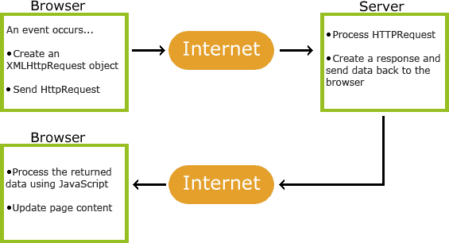
AJAX

Slide 84
AJAX
• An event occurs in a web page (the page is loaded, a button is clicked)
• An XMLHttpRequest object is created by JavaScript
• The XMLHttpRequest object sends a request to a web server
• The server processes the request
• The server sends a response back to the web page
• The response is read by JavaScript
• Proper action (like page update) is performed by JavaScript

Slide 85
AJAX
Advantages of ajax:
1) Almost supports all modern browsers
2) Reduce the traffic travels between the client and the server. 3)Response time is faster so increases performance and speed.
4) Many open source javaScript libraries available for ajax support like JQuery, Prototype, etc.
5) Asynchronous data retrieval using XmlHttpRequest. Hence, allows you to perform multiple tasks simultaneously.
6) Complete ajax based application gives the feeling of desktop application

Slide 86
AJAX–Introduction-Asynchronous
Disadvantages of ajax:
1) Browser compatibility issues
2) Search engine would not crawl ajax generated content. Hence, Search Engines like Google cannot index AJAX pages.
3) Impossible to bookmark ajax updated page content
4) Security is less in AJAX application as all files are downloadable at client side.

Slide 87
AJAX
XMLHttpRequest object
The XMLHttpRequest object is the key to AJAX. It has been available ever since Internet Explorer 5.5 was released in July 2000, but was not fully discovered until AJAX and Web 2.0 in 2005 became popular.
XMLHttpRequest (XHR) is an API that can be used by JavaScript, JScript, VBScript, and other web browser scripting languages to transfer and manipulate XML data to and from a webserver using HTTP, establishing an independent connection channel between a webpage's Client-Side and Server- Side.

Slide 88
AJAX
The data returned from XMLHttpRequest calls will often be provided by back-end databases. Besides XML, XMLHttpRequest can be used to fetch data in other formats, e.g. JSON or even plain text.
Syntax
Variable= new XMLhttpRequest();
An object of XMLHttpRequest is used for asynchronous communication between client and server. It performs following operations:
1. Sends data from the client in the background.
2. Receives the data from the server.
3. Updates the webpage without reloading it.

Slide 89
AJAX
Properties of XMLHttpRequest object
The common properties of XMLHttpRequest object are as follows:
Property | Description
onReadyStateChange | It is called whenever readystate attribute changes. It must not be used with synchronous requests.
ReadyState | represents the state of the request. It ranges from 0 to 4. 0: request not initialized 1: server connection established 2: request received 3: processing request 4: request finished and response is ready
ReponseText | returns response as text.
ReponseText | returns response as text.

Slide 90
AJAX
Methods of XMLHttpRequest object
The important methods of XMLHttpRequest object are as follows
Method | Description
void open(method, URL) | opens the request specifying get or post method and url.
void open(method, URL, async) | same as above but specifies asynchronous or not.
void open(method, URL, async, username, password) | same as above but specifies username and password.
void send() | sends get request.
void send(string) | send post request.
setRequestHeader(header,value) | it adds request headers.

Slide 91
AJAX
How AJAX works?
AJAX communicates with the server using XMLHttpRequest object. Let's try to understand the flow of ajax or how ajax works by the image displayed below.
1. User sends a request from the UI and a javascript call goes to XMLHttpRequest object.
2. HTTP Request is sent to the server by XMLHttpRequest object.
3. Server interacts with the database using JSP, PHP, Servlet, ASP.net etc.
Data is retrieved.
Server sends XML data or JSON data to the XMLHttpRequest callback function.
6. HTML and CSS data is displayed on the browser.

Slide 92
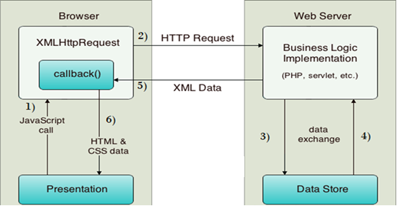
AJAX

Slide 93
AJAX
Ajax Example
• To create ajax example, you need to use any server-side language e.g. servlet, jsp, php, asp.net etc. Here we are using JSP for generating the server-side code.
• In this example, we are simply printing the table of the given number.
Steps to create ajax example with jsp
1. load the org.json.jar file
2. create input page to receive any text or number
3. create server side page to process the request
4. provide entry in web.xml file

Slide 94
AJAX
<html>
<head>
<script>
var request; function sendInfo()
{
var v=document.vinform.t1.value; var url="index.jsp?val="+v; if(window.XMLHttpRequest)
{
request=new XMLHttpRequest();
}
try
{
Else if(window.ActiveXObject)
{
request=new ActiveXObject("Microsoft.XMLHTTP");
}
request.onreadystatechange=getInfo; request.open("GET",url,true); request.send();
}
catch(e)
{
alert("Unable to connect to server");
}
}
function getInfo(){ if(request.readyState==4){ var val=request.responseText; document.getElementById('amit').innerHTML=val;
}
}

Slide 95
AJAX
</script>
</head>
<body>
<marquee><h1>This is an example of ajax</h1></marquee>
<form name="vinform">
<input type="text" name="t1">
<input type="button" value="ShowTable" onClick="sendInfo()">
</form>
<span id="amit"> </span>
</body>
</html>
Create server side page to process the request
index.jsp
<%
int n=Integer.parseInt(request.getParameter("val")); for(int i=1;i<=10;i++) out.print(i*n+"<br>");
%>

Slide 96
AJAX
web.xml
<?xml version="1.0" encoding="UTF-8"?>
<web-app version="2.5" xmlns="http://java.sun.com/xml/ns/javaee" xmlns:xsi="http://www.w3.org/2001/XMLSchema-instance"
xsi:schemaLocation="http://java.sun.com/xml/ns/javaee http://java.sun.com/xml/ns/javaee/web- app_2_5.xsd">
<session-config>
<session-timeout> 30 </session-timeout>
</session-config>
<welcome-file-list>
<welcome-file>table1.html</welcome-file>
</welcome-file-list>
</web-app>

Slide 97
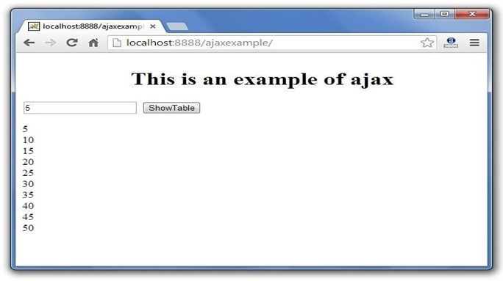
AJAX

